Slide 1
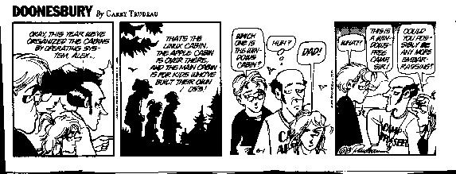
TCP Model Revisited and
Network Layer Introduced
Dr. Shelly Heller
sheller@gwu.edu

Slide 2
Chapter 3: Transport Layer
Chapter goals:
understand principles behind transport layer services:
  multiplexing/demultiplexing
  reliable data transfer
  flow control
  congestion control
instantiation and implementation in the Internet
Chapter Overview:
transport layer services
multiplexing/demultiplexing
connectionless transport: UDP
principles of reliable data transfer
connection-oriented transport: TCP
  reliable transfer
  flow control
  connection management
principles of congestion control
TCP congestion control
✓
✓
✓
✓

Slide 3
TCP congestion control:
“probing” for usable bandwidth:
  ideally: transmit as fast as possible (Congwin as large as possible) without loss
  increase Congwin until loss (congestion)
  loss: decrease Congwin, then begin probing (increasing) again
two “phases”
  slow start
  congestion avoidance
important variables:
  Congwin
  threshold: defines threshold between two slow start phase, congestion control phase
Notes:
TCP has two methods for controlling the packets on the net
The main difference between flow control and congestion control is that the flow control is a mechanism that controls the traffic between sender and receiver. On the other hand, the congestion control mechanism controls the traffic that is placed by the transport layer into the network.
Flow Control: Sender will send enough data that can be accommodated at the receiver end. Congestion Control: Sender will reduce the amount of sent packets to avoid overflowing the router's buffer(Queue). Flow Control: It makes sure that the sender does not overload the receiver.
In response to stop and wait protocols, we have developed two pipelining protocols – GBN and selective repeat
Flow control whereby the number of packets released is monitored
And congestion control whereby the traffic on the net is inferred and then the number of packets at a time that are released is controlled

Slide 4

TCP Slowstart
Host A
Host B
Slowstart algorithm
one segment
initialize: Congwin = 1
for (each segment ACKed)
Congwin++
until (loss event OR
CongWin > threshold)
RTT
two segments
four segments
exponential increase (per RTT) in window size (not so slow!)
loss event: timeout (Tahoe TCP) and/or or three duplicate ACKs (Reno TCP)
time
Notes:
So, what is the start threshold? Can set threshold very high and wait for time-out indicating loss event
Your choice of threshold can impact the congestion control, you can set it arbitrarily at say 8*MSS or you can poll
Instead, TCP Reno does the following:
guesses at a reasonable initial window size, using a form of polling
Start at 1 MSS, and double it until time out Once you are at threshold AND not at loss, you can increase MSS window by 1 MSS until you loss out

Slide 5
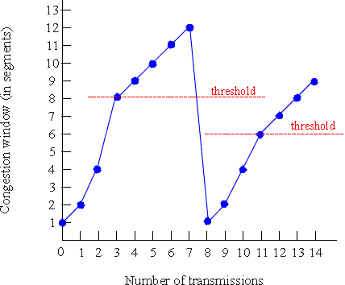
TCP Congestion Avoidance
Congestion avoidance
/* slowstart is over */
/* Congwin > threshold */
Until (loss event) {
every w segments ACKed:
Congwin++
}
threshold = Congwin/2
Congwin = 1
perform slowstart
1
1: TCP Reno skips slowstart (fast
recovery) after three duplicate ACKs
Notes:
At a loss, set the threshold to half od current window! Not loss at 12, set threshold to 6 and now either go back to slow start or begin where left off for fast recovery

Slide 6
Fast recovery
What to do in the face of loss?
  Restart at 1MSS as in TCP Tahoe
  Fast Recovery as in TCP Reno
    Reset to sending window to MSS size of reset threshold

Slide 7
TCP Fairness
AIMD
TCP congestion avoidance:
AIMD: additive increase, multiplicative decrease
  increase window by 1 per RTT
  decrease window by factor of 2 on loss event
Fairness goal: if N TCP sessions share same bottleneck link, each should get 1/N of link capacity
TCP connection 1
TCP
connection 2
bottleneck
router
capacity R

Slide 8
TCP latency modeling
Q: How long does it take to receive an object from a Web server after sending a request?
TCP connection establishment
data transfer delay
Notation, assumptions:
Assume one link between client and server of rate R
Assume: fixed congestion window, W segments
S: MSS (bits)
O: object size (bits)
no retransmissions (no loss, no corruption)
So: lower limit is 2RTT+0/R
Two cases to consider:
WS/R > RTT + S/R: ACK for first segment in window returns before window’s worth of data sent
WS/R < RTT + S/R: wait for ACK after sending window’s worth of data sent

Slide 9
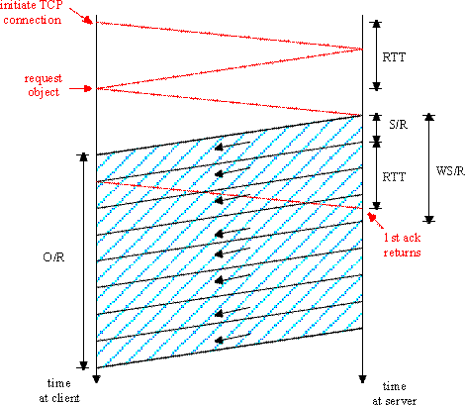
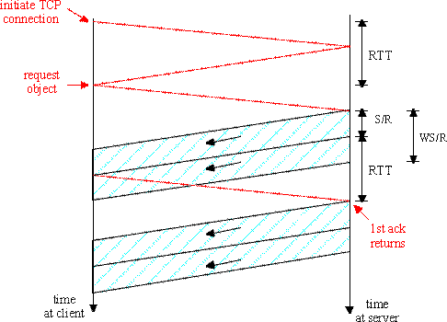
TCP latency Modeling
W=4
W=2
RTT
RTT
Latency
Case 1: latency = 2RTT + O/R
Case 2: latency = 2RTT + O/R
+ (K-1)[S/R + RTT - WS/R]
Where K:= O/WS

Slide 10
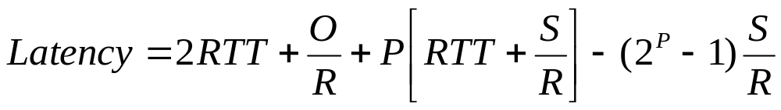

TCP Latency Modeling: Slow Start
Now suppose window grows according to slow start.
Will show that the latency of one object of size O is:
where P is the number of times TCP stalls at server:
- where Q is the number of times the server would stall
if the object were of infinite size.
- and K is the number of windows that cover the object.

Slide 11
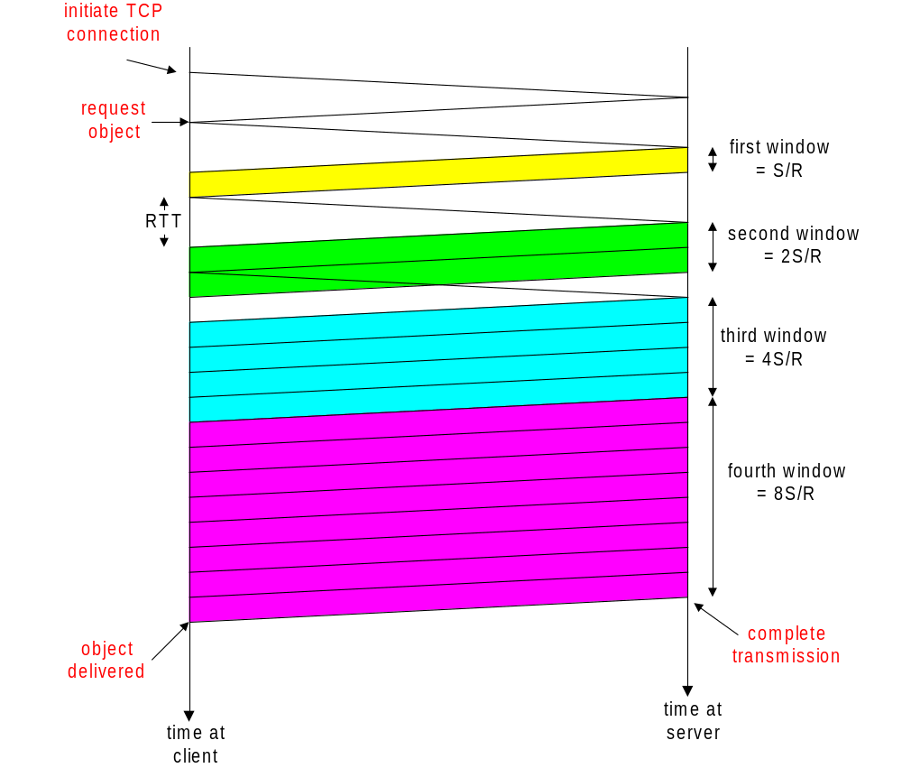
TCP Latency Modeling: Slow Start (cont.)
Example:
O/S = 15 segments
K = 4 windows
Q = 2
P = min{K-1,Q} = 2
Server stalls P=2 times.

Slide 12
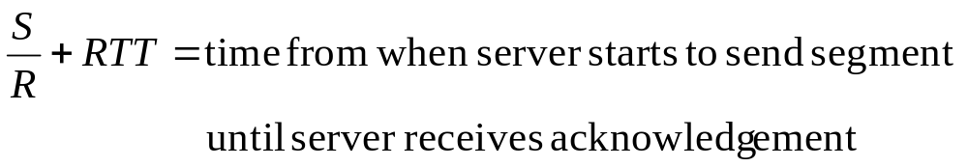
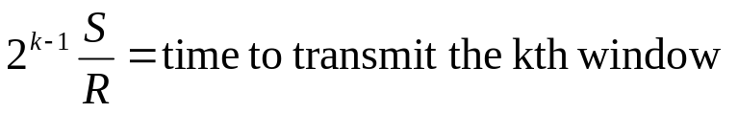
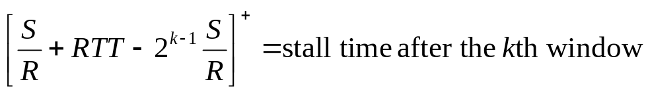
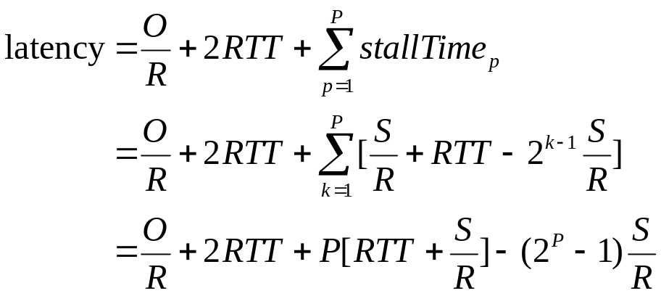
TCP Latency Modeling: Slow Start (cont.)
RTT
Q
P = min { [log₂(1 + RTTxR/S)] + 1, K-1}

Slide 13
Example Latencies
For S = 536 bytes, RTT = 100ms, O = 100Kbytes (K = 8):
Min Latency Latency w/
R O/R P O/R + 2RTT slow start
28Kbps 28.6 sec 1 28.8 sec 28.9 sec
100Kbps 8 sec 2 8.2 sec 8.4 sec
1Mbps 800 msec 5 1 sec 1.5 sec
10Mbps 80 msec 7 0.28 sec 0.98 sec
For S = 536 bytes, RTT = 100ms, O = 5Kbytes (K = 4):
Min Latency Latency w/
R O/R P O/R + 2RTT slow start
28Kbps 1.43 sec 1 1.63 sec 1.73 sec
100Kbps 0.4 sec 2 0.6 sec 0.76 sec
1Mbps 40 msec 3 0.24 sec 0.52 sec
10Mbps 4 msec 3 0.20 sec 0.50 sec

Slide 14
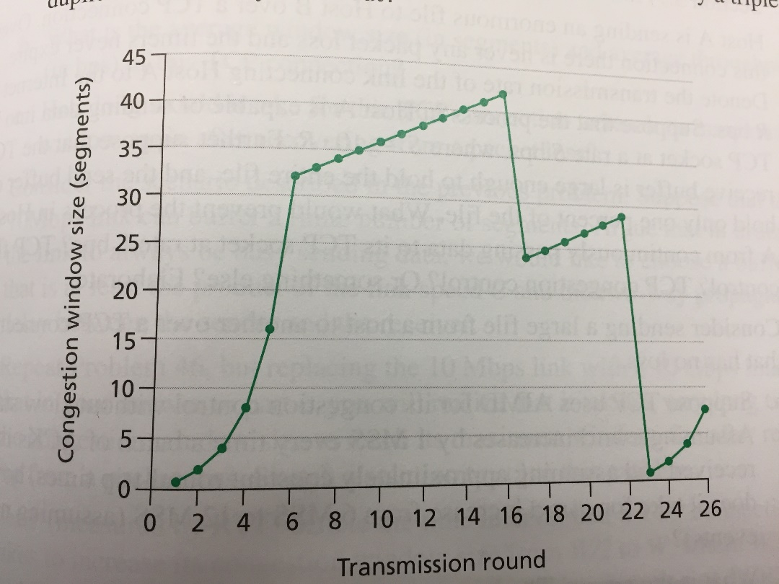
Work with a neighbor
Using the image on this page
Where is slow start?
Where is congestion control
What is the cause of the threshold reset?
Resent to what?
What would Tahoe do?
What would Reno do?

Slide 15
Chapter 4: Network Layer
Chapter goals:
understand principles behind network layer services:
  routing (path selection)
  dealing with scale
  how a router works
  advanced topics: IPv6, multicast
instantiation and implementation in the Internet
Chapter Overview:
network layer services
routing principle: path selection
hierarchical routing
IP
Internet routing protocols reliable transfer
  intra-domain
  inter-domain
what’s inside a router?
IPv6
multicast routing

Slide 16
















Network layer
transport segment from sending to receiving host
on sending side encapsulates segments into datagrams
on receiving side, delivers segments to transport layer
network layer protocols in every host, router
router examines header fields in all IP datagrams passing through it
application
transport
network
data link
physical
network
data link
physical
network
data link
physical
network
data link
physical
network
data link
physical
network
data link
physical
network
data link
physical
network
data link
physical
network
data link
physical
network
data link
physical
application
transport
network
data link
physical
network
data link
physical
network
data link
physical
Network Layer: Data Plane
4-<number>

Slide 17
Two key network-layer functions
network-layer functions:
forwarding: move packets from router’s input to appropriate router output
routing: determine route taken by packets from source to destination
  routing algorithms
analogy: taking a trip
forwarding: process of getting through single interchange
routing: process of planning trip from source to destination
Network Layer: Data Plane
4-<number>

Slide 18
Network layer: data plane, control plane
Data plane
local, per-router function
determines how datagram arriving on router input port is forwarded to router output port
forwarding function
Control plane
network-wide logic
determines how datagram is routed among routers along end-end path from source host to destination host
two control-plane approaches:
  traditional routing algorithms: implemented in routers
  software-defined networking (SDN): implemented in (remote) servers
values in arriving
packet header
0111
1
3
2
Network Layer: Data Plane
4-<number>

Slide 19





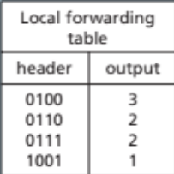
Per-router control plane
Individual routing algorithm components in each and every router interact in the control plane
Routing
Algorithm
control
plane
data
plane
values in arriving
packet header
0111
1
3
2
Network Layer: Control Plane
5-<number>

Slide 20


Logically centralized control plane
A distinct (typically remote) controller interacts with local control agents (CAs)
Remote Controller
control
plane
data
plane
CA
CA
CA
CA
CA
values in arriving
packet header
0111
1
3
2
Network Layer: Control Plane
5-<number>

Slide 21
Network service model
Q: What service model for “channel” transporting datagrams from sender to receiver?
example services for individual datagrams:
guaranteed delivery
guaranteed delivery with less than 40 msec delay
example services for a flow of datagrams:
in-order datagram delivery
guaranteed minimum bandwidth to flow
restrictions on changes in inter-packet spacing
Network Layer: Data Plane
4-<number>

Slide 22




Network layer functions
transport packet from sending to receiving hosts
network layer protocols in every host, router
application
transport
network
data link
physical
network
data link
physical
network
data link
physical
network
data link
physical
network
data link
physical
three important functions:
path determination: route taken by packets from source to dest. Routing algorithms
switching: move packets from router’s input to appropriate router output
call setup: some network architectures require router call setup along path before data flows
network
data link
physical
network
data link
physical
network
data link
physical
network
data link
physical
application
transport
network
data link
physical

Slide 23
Network service model
Q: What service model for “channel” transporting packets from sender to receiver?
guaranteed bandwidth?
preservation of inter-packet timing (no jitter)?
loss-free delivery?
in-order delivery?
congestion feedback to sender?
The most important
abstraction provided
by network layer:
?
?
virtual circuit
or
datagram?
?
service abstraction

Slide 24
Virtual circuits
“source-to-dest path behaves much like telephone circuit”
  performance-wise
  network actions along source-to-dest path
call setup, teardown for each call before data can flow
each packet carries VC identifier (not destination host ID)
every router on source-destination path s maintain “state” for each passing connection
  transport-layer connection only involved two end systems
link, router resources (bandwidth, buffers) may be allocated to VC
  to get circuit-like performance

Slide 25
Virtual circuits: signaling protocols
used to setup, maintain teardown VC
used in ATM (Asynchronous transfer mode), frame-relay, X.25
not used in today’s Internet
application
transport
network
data link
physical
5. Data flow begins
6. Receive data
application
transport
network
data link
physical
4. Call connected
3. Accept call
1. Initiate call
2. incoming call
Notes:
an initial setup phase is used to set up a fixed route between the intermediate nodes for all packets which are exchanged during a session between the end nodes (analogous to the circuit-switched telephony network). At each intermediate node, an entry is made in a table to indicate the route for the connection that has been set up. Packets can then use short headers, since only identification of the virtual circuit rather than complete destination address is needed. The intermediate nodes (B,C) process each packet according to the information which was stored in the node when the connection was established.
Enhancements to provide reliability may also be provided. Delivery of packets in proper sequence and with essentially no errors is guaranteed, and congestion control to minimise queuing is common. Delays are more variable than they are with a dedicated circuit, however, since several virtual circuits may compete for the same resources. An initial connection setup phase and a disconnect phase at the end of data transfer are required (as in the circuit-switched network). The most common form of virtual circuit network were ATM and X.25, which for a while were commonly used for public packet data networks.

Slide 26
Datagram networks: the Internet model
no call setup at network layer
routers: no state about end-to-end connections
  no network-level concept of “connection”
packets typically routed using destination host ID
  packets between same source-dest pair may take different paths
application
transport
network
data link
physical
application
transport
network
data link
physical
1. Send data
2. Receive data
Notes:
There are a number of important differences between virtual circuit and datagram networks. The choice strongly impacts complexity of the different types of node. Use of datagrams between intermediate nodes allows relatively simple protocols at this level, but at the expense of making the end (user) nodes more complex when end-to-end virtual circuit service is desired.
The Internet transmits datagrams between intermediate nodes using IP. Most Internet users need additional functions such as end-to-end error and sequence control to give a reliable service (equivalent to that provided by virtual circuits). This reliablility may be provided by the Transmission Control Protocol (TCP) which is used end-to-end across the Internet, or by applications such as the trivial file transfer protocol (tftp) running on top of the User Datagram Protocol (UDP).

Slide 27
Network layer service models:
Network
Architecture
Internet
ATM
ATM
ATM
ATM
Service
Model
best effort
CBR
VBR
ABR
UBR
Guarantees ?
Congestion
feedback
no (inferred
via loss)
no
congestion
no
congestion
yes
no
Bandwidth
none
constant
rate
guaranteed
rate
guaranteed
minimum
none
Loss
no
yes
yes
no
no
Order
no
yes
yes
yes
yes
Timing
no
yes
yes
no
no
Internet model being extended: Intserv, Diffserv
  Chapter 6
Notes:
ABR Available bit rate
VBR variable bit rate
CBR constant bit rate
Careful – this is the service model of the network layer – so where do the loss, order and any timing guanrantess come from?

Slide 28
Datagram or VC network: why?
Internet
data exchange among computers
  “elastic” service, no strict timing req.
“smart” end systems (computers)
  can adapt, perform control, error recovery
  simple inside network, complexity at “edge”
many link types
  different characteristics
  uniform service difficult
ATM
evolved from telephony
human conversation:
  strict timing, reliability requirements
  need for guaranteed service
“dumb” end systems
  telephones
  complexity inside network

Slide 29
Routing
Routing protocol
Goal: determine “good” path
(sequence of routers) thru
network from source to dest.
5
B
3
C
2
5
A
2
1
F
Graph abstraction for routing algorithms:
graph nodes are routers
graph edges are physical links
  link cost: delay, $ cost, or congestion level
3
1
2
D
E
1
“good” path:
  typically means minimum cost path
  other def’s possible

Slide 30
Routing Algorithm classification
Global or decentralized information?
Global:
all routers have complete topology, link cost info
“link state” algorithms
Decentralized:
router knows physically-connected neighbors, link costs to neighbors
iterative process of computation, exchange of info with neighbors
“distance vector” algorithms
Static or dynamic?
Static:
routes change slowly over time
Dynamic:
routes change more quickly
  periodic update
  in response to link cost changes

Slide 31
A Link-State Routing Algorithm
Dijkstra’s algorithm
net topology, link costs known to all nodes
  accomplished via “link state broadcast”
  all nodes have same info
computes least cost paths from one node (‘source”) to all other nodes
  gives routing table for that node
iterative: after k iterations, know least cost path to k dest.’s
Notation:
c(i,j): link cost from node i to j. cost infinite if not direct neighbors
D(v): current value of cost of path from source to dest. V
p(v): predecessor node along path from source to v, that is next v
N: set of nodes whose least cost path definitively known

Slide 32
A Sample Path- shortest path a to c
5
3
B
C
2
5
A
2
F
1
3
1
2
D
E
1

Slide 33
Dijsktra’s Algorithm
1 Initialization:
2 N = {A}
3 for all nodes v
4 if v adjacent to A
5 then D(v) = c(A,v)
6 else D(v) = infty
7
8 Loop
9 find w not in N such that D(w) is a minimum
10 add w to N
11 update D(v) for all v adjacent to w and not in N:
12 D(v) = min( D(v), D(w) + c(w,v) )
13 /* new cost to v is either old cost to v or known
14 shortest path cost to w plus cost from w to v */
15 until all nodes in N
Update P as well

Slide 34
Dijkstra’s algorithm: example
Step
0
1
2
3
4
5
start N
A
AD
ADE
ADEB
ADEBC
ADEBCF
D(B),p(B)
2,A
2,A
2,A
D(C),p(C)
5,A
4,D
3,E
3,E
D(D),p(D)
1,A
D(E),p(E)
infinity
2,D
D(F),p(F)
infinity
infinity
4,E
4,E
4,E
5
B
3
C
2
5
A
2
1
F
3
1
2
D
E
1

Slide 35
Let’s Watch the algorithm in action
The Dijkstra Algorithm

Slide 36
Dijkstra’s algorithm, discussion
Algorithm complexity: n nodes
each iteration: need to check all nodes, w, not in N
n*(n+1)/2 comparisons: O(n**2)
more efficient implementations possible: O(nlogn)
Oscillations possible:
e.g., link cost = amount of carried traffic
1
A
A
A
A
1+e
2+e
0
0
2+e
2+e
0
D
0
0
B
D
B
D
B
D
B
1+e
1
0
0
1+e
1
0
e
0
0
1
1+e
0
e
C
C
C
C
1
1
e
… recompute
routing
… recompute
… recompute
initially
Notes:
And we have to know the entire graph

Slide 37
Network layer functions
transport packet from sending to receiving hosts
network layer protocols in every host, router
application
transport
network
data link
physical
network
data link
physical
network
data link
physical
network
data link
physical
network
data link
physical
three important functions:
path determination: route taken by packets from source to dest. Routing algorithms
switching: move packets from router’s input to appropriate router output
call setup: some network architectures require router call setup along path before data flows
network
data link
physical
network
data link
physical
network
data link
physical
network
data link
physical
application
transport
network
data link
physical

Slide 38
Link State Routing
3 main elements:
  Knowledge about the neighborhood only
  Each router sends to all routers – “flooding”
  Information sharing when there is a change

Slide 39
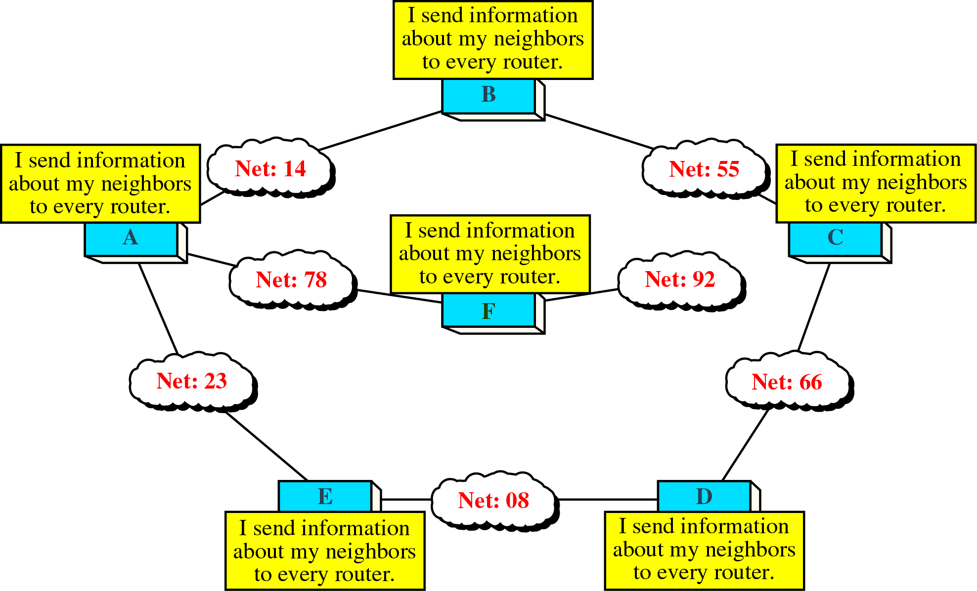
Concept of Link State Routing

Slide 40
Distance Vector Routing Algorithm
iterative:
continues until no nodes exchange info.
self-terminating: no “signal” to stop
asynchronous:
nodes need not exchange info/iterate in lock step!
distributed:
each node communicates only with directly-attached neighbors
Distance Table data structure
each node has its own
row for each possible destination
column for each directly-attached neighbor to node
example: in node X, for dest. Y via neighbor Z:
distance from X to
Y, via Z as next hop
D^{X} (Y,Z)
=
Z
=
c(X,Z) + min {D (Y,w)}
w
Bellman Ford

Slide 41
Tables of routing information
B
1
C
7
Full view for class, BUT each Node has its own table of what it can see, Set to 0 for itself and inf for those it cant reach
A
8
2
1
E
D
2
D from E | Cost to A | Cost to B | Cost to C | Cost to D | Cost to E
A | 0 | 7 | Infinity | inf | 1
B | 8 | 0 | 2 | Infin | 2
C | inf | 1 | 0 | 2 | inf
D | inf | inf | 2 | 0 | 2
E | 1 | 8 | inf | 2 | 0
e.g. E would send vector {A,1;B,8;D,2: and E,0} to A,B and D

Slide 42
Distance Table: example
E to A via B
8+min path of
B to C to D to E to A
1
cost to destination via
B
C
E
7
D ()
A
B
C
D
A
1
7
6
4
B
14
8
9
11
D
5
5
4
2
A
8
2
1
E
D
2
E
D
D (C,D)
=
c(E,D) + min {D (C,w)}
destination
w
=
2+2 = 4
E
D
D (A,D)
=
c(E,D) + min {D (A,w)}
w
=
2+3 = 5
loop!
E
B
D (A,B)
=
c(E,B) + min {D (A,w)}
w
=
8+6 = 14
loop!

Slide 43
Distance table gives routing table
cost to destination via
E
Outgoing link
to use, cost
D ()
A
B
C
D
A
1
7
6
4
B
14
8
9
11
D
5
5
4
2
A
B
C
D
A,1
D,5
D,4
D,2
From E to
destination
destination
Distance table
Routing table

Slide 44
Distance Vector Routing: overview
Iterative, asynchronous: each local iteration caused by:
local link cost change
message from neighbor: its least cost path change from neighbor
Distributed:
each node notifies neighbors only when its least cost path to any destination changes
  neighbors then notify their neighbors if necessary
Each node:
wait for (change in local link cost of msg from neighbor)
recompute distance table
if least cost path to any dest has changed, notify neighbors

Slide 45
Distance Vector Algorithm:
At all nodes, X:
1 Initialization:
2 for all adjacent nodes v:
3 D^{X} (*,v) = infty /* the * operator means "for all rows" */
4 D^{X} (v,v) = c(X,v)
5 for all destinations, y
6 send min_{w} D^{X} (y,w) to each neighbor /* w over all X's neighbors */

Slide 46
Distance Vector Algorithm (cont.):
8 loop
9 wait (until I see a link cost change to neighbor V
10 or until I receive update from neighbor V)
11
12 if (c(X,V) changes by d)
13 /* change cost to all dest's via neighbor v by d */
14 /* note: d could be positive or negative */
15 for all destinations y: D^{X} (y,V) = D^{X} (y,V) + d
16
17 else if (update received from V wrt destination Y)
18 /* shortest path from V to some Y has changed */
19 /* V has sent a new value for its min_{w} DV(Y,w) */
20 /* call this received new value is "newval" */
21 for the single destination y: D^{X}(Y,V) = c(X,V) + newval
22
23 if we have a new min_{w} D^{X} (Y,w)for any destination Y
24 send new value of min_{w} D^{X} (Y,w) to all neighbors
25
26 forever

Slide 47
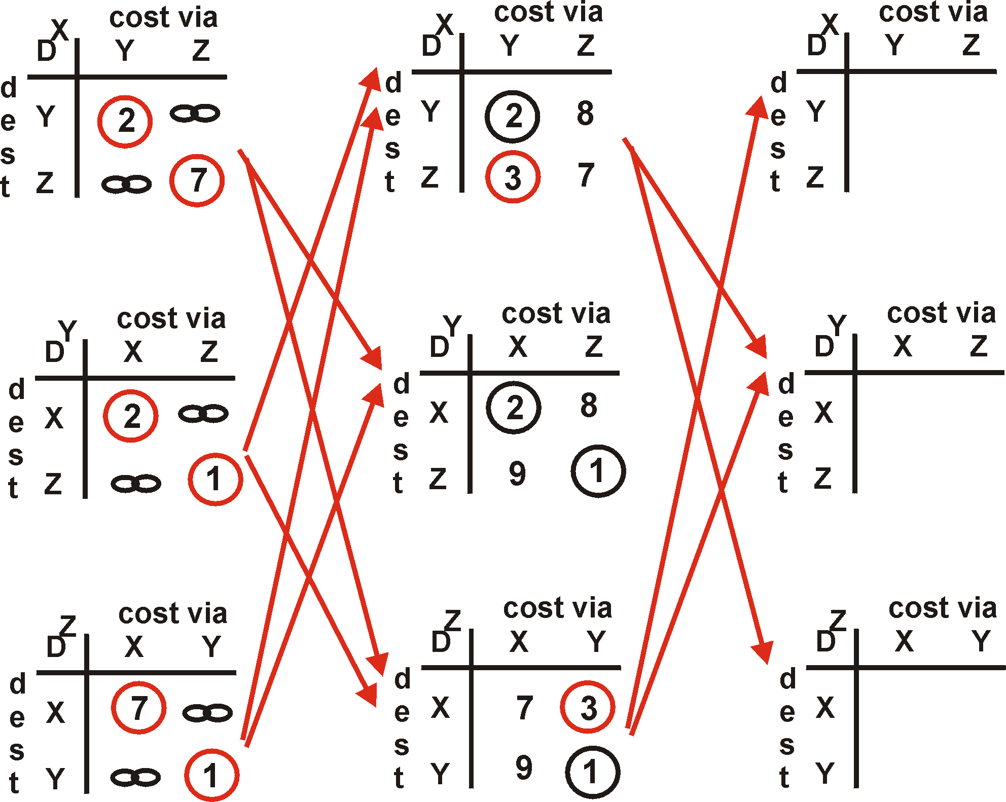
Distance Vector Algorithm: example
One
Hop
Two
Hops
Y
2
1
X
Z
7
Don’t know yet
e.g 2nd hop from
Y to x via x (1)
y to x via z
we now know x to z cost 7, total cost is 8

Slide 48
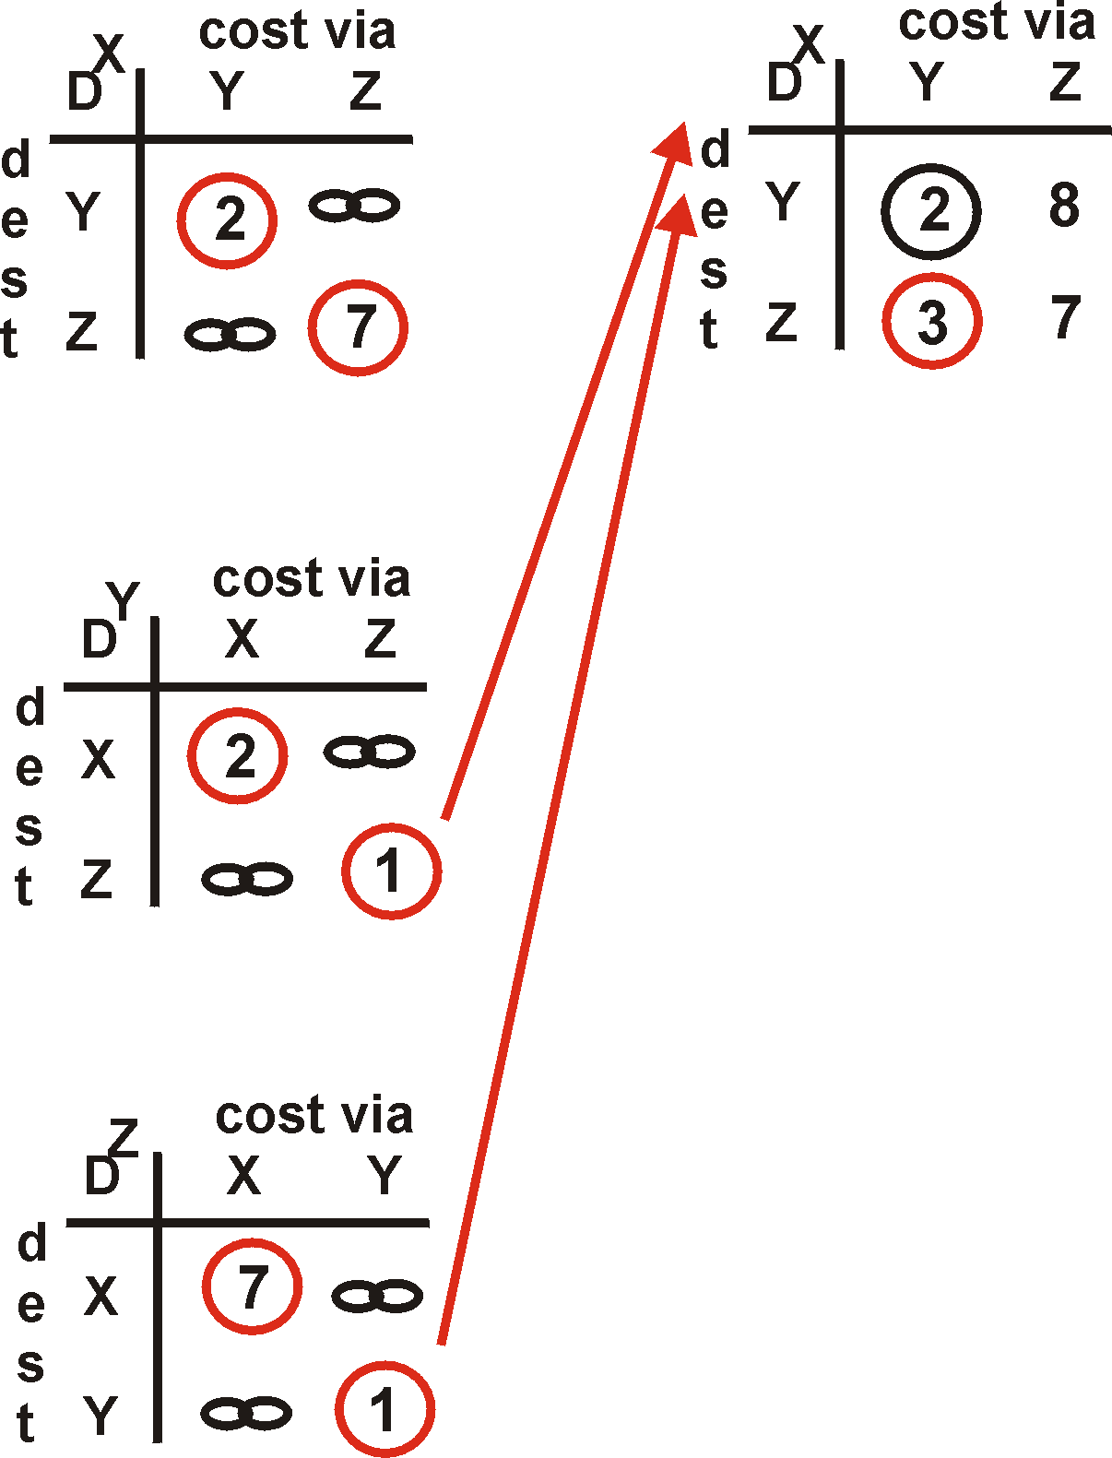
Distance Vector Algorithm: example
Y
2
1
X
Z
X
Z
7
D (Y,Z)
=
c(X,Z) + min {D (Y,w)}
w
=
7+1 = 8
X
Y
D (Z,Y)
=
c(X,Y) + min {D (Z,w)}
w
=
2+1 = 3

Slide 49
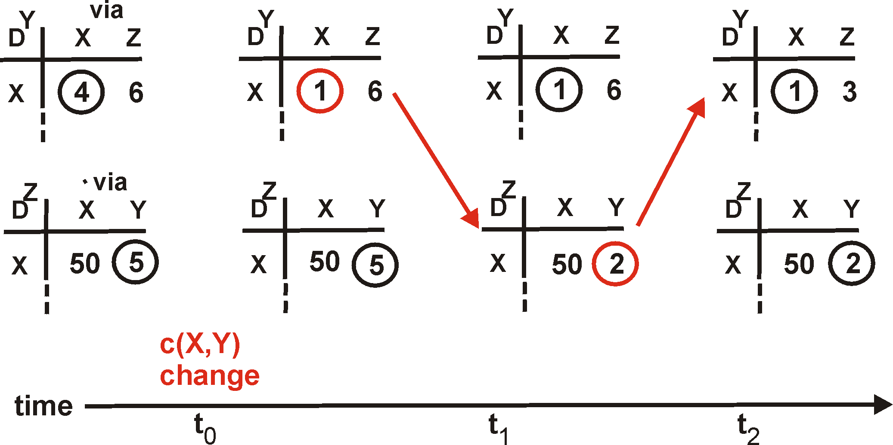
Distance Vector: link cost changes
Link cost changes:
node detects local link cost change
updates distance table (line 15)
if cost change in least cost path, notify neighbors (lines 23,24)
1
Y
4
1
X
Z
50
algorithm
terminates
“good
news
travels
fast”

Slide 50
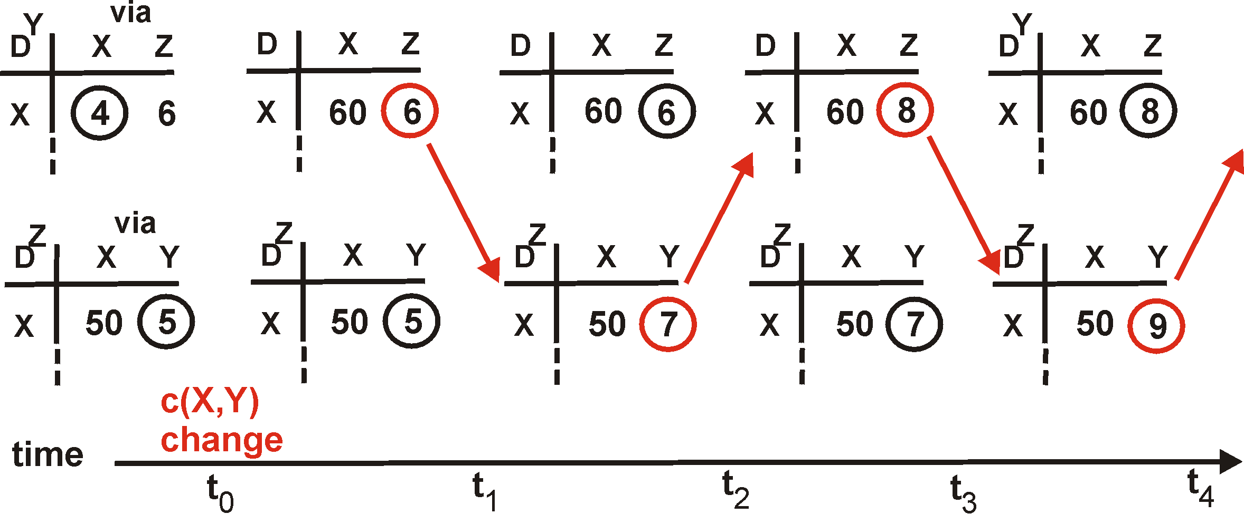
Distance Vector: link cost changes
Link cost changes:
good news travels fast
bad news travels slow - “count to infinity” problem!
60
Y
4
1
X
Z
50
algorithm
continues
on!

Slide 51
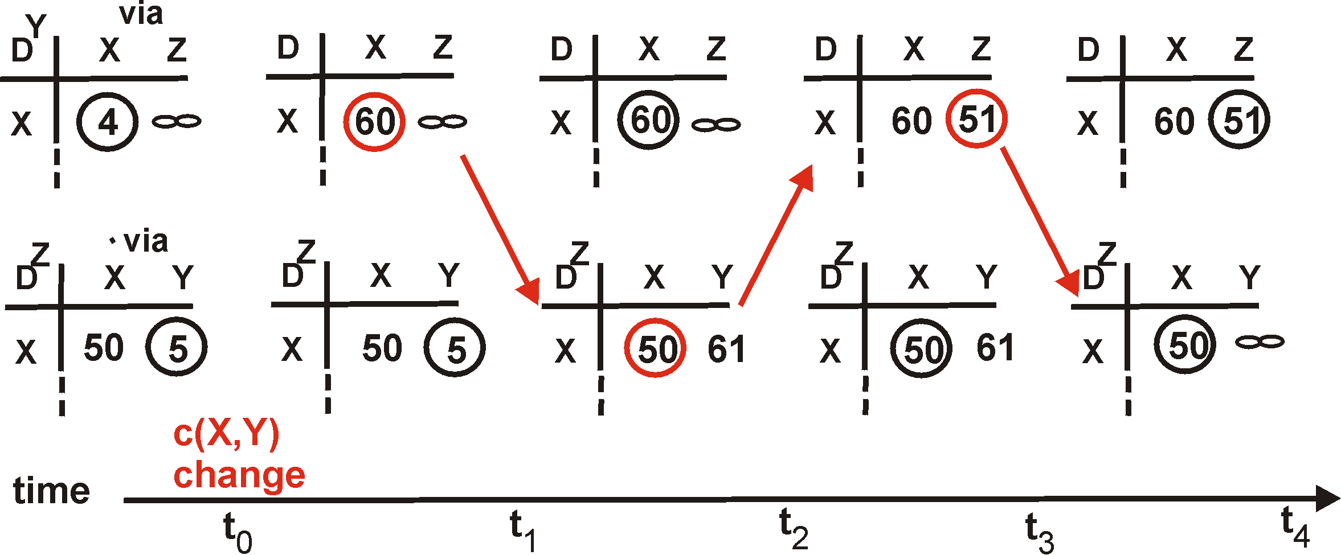
Distance Vector: poisoned reverse
If Z routes through Y to get to X :
Z tells Y its (Z’s) distance to X is infinite (so Y won’t route to X via Z)
will this completely solve count to infinity problem?
60
Y
4
1
X
Z
50
algorithm
terminates

Slide 52
Comparison of LS and DV algorithms
Message complexity
LS: with n nodes, E links, O(nE) msgs sent each
DV: exchange between neighbors only
  convergence time varies
Speed of Convergence
LS: O(n**2) algorithm requires O(nE) msgs
  may have oscillations
DV: convergence time varies
  may be routing loops
  count-to-infinity problem
Robustness: what happens if router malfunctions?
LS:
  node can advertise incorrect link cost
  each node computes only its own table
DV:
  DV node can advertise incorrect path cost
  each node’s table used by others
    error propagate thru network

Slide 53
One last trace of distance Vector
7
2
3
3
6

